Slide 1
Shiny Workshop Day 2
August 28, 2019
TEA Analytics

Slide 2
Lunch Time To-Do List
Git setup.
Connect to GitHub account.

Slide 3
TEA Shiny Server & Deployment

Slide 4
Shiny Server
It’s a web server that makes shiny apps available over the web.
PROD server
https://analyze.teainc.org
Apps are accessible from anywhere
Staging server
http://rshinydev001:3838/
Apps are available only within TEA network.
FYI:
Operating System: Linux
Maintainer: Brandon Clayton

Slide 5
Deployment Steps
Dev
Develop an app locally.
Staging
Place the app folder in Staging location: \\analystfs\westcoastdata\Shiny\Staging
Check your app on http://rshinydev001:3838/
If debugging is needed, do so here: http://rshinydev001:8787/
PROD
Once all working, place the folder here: \\analystfs\westcoastdata\Shiny\Prod
Check your app on https://analyze.teainc.org/
Debug if necessary: http://rshiny001:8787
Check configurations with Brandon.

Slide 6
Demo
Deployment to Staging

Slide 7
Deployment Steps with optional steps
Dev
Develop an app locally.
Staging
Place the app folder in Staging location: \\analystfs\westcoastdata\Shiny\Staging
Check your app on http://rshinydev001:3838/
If debugging is needed, do so here: http://rshinydev001:8787/
PROD
Once all working, place the folder here: \\analystfs\westcoastdata\Shiny\Prod
Check your app on https://analyze.teainc.org/
Debug if necessary: http://rshiny001:8787
Check configurations with Brandon.
Track code changes in github.
Push local changes to remote staging branch.
Have users check the app.
Merge staging branch into master.
Release with a version number.
Announcement to users.

Slide 8
App Configurations
User Groups
Timeout
Default: 30 min

Slide 9
Accessing Network Files
Certain network locations are visible from Shiny Server. (Mounting).
\\Analystfs\westcoastdata
→ /mnt/analystfs/westcoastdata
\\seaanalystfs1\Data
→ /mnt/seaanalyst1/data
Working directory is always the shiny app folder. If files are placed inside the app folder, use relative path.
Watch out if you have a path to a file in the network.
Make a copy in an available location and use a mounted path. (different path names for Dev vs PROD).
Place the data in a database.

Slide 10
External Client Access
Questions to ask:
Can we get away without giving access? (We are service providers, not app provider).
Do you have to limit the access?
Are there any sensitive data or tabs to hide?
Pre-set user inputs.
Error handling
Meaningful messages.
Safe errors.
Is it vulnerable to misinterpretation?
Disclaimer and signature page.
Who’s in charge for customer support?
Support plans
When it fails, what’s the procedure for support?

Slide 11
Known Issues

Slide 12
Error at Opening
At opening, you may encounter an error which goes away by refreshing the page a few times.
Cause: The linux machine need to look into \\analystfs network locations. There seems to be a glitch somewhere.
Solution:
If we like this app file locations, no solutions have been found so far.
If we don’t mind using file transfer apps, we could place app files within the server machine…

Slide 13
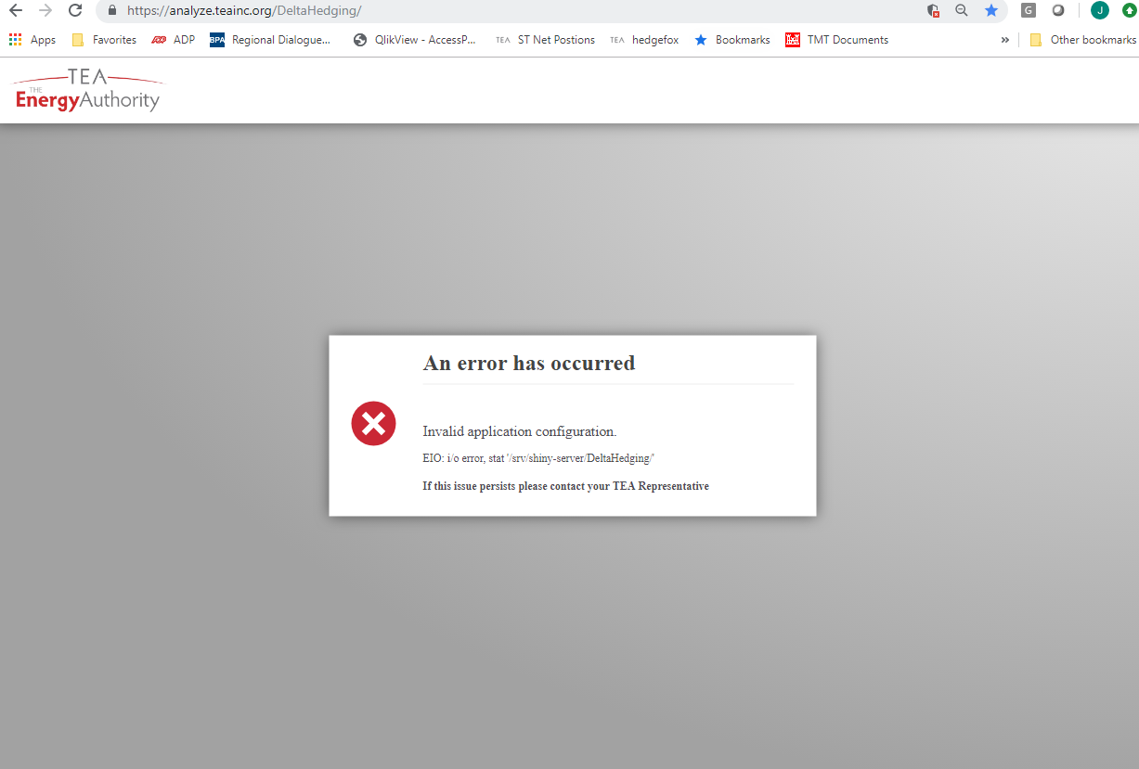

Slide 14
Version Management
We all share the same Shiny Servers.
We share the same R version and package versions on the server regardless of what you use locally.
Current R: Version 3.4.4 (2018-03-15) -- "Someone to Lean On”
We plan to update it on XXXXXXX.
Agree on a version to install.
Update Staging server.
Everyone check apps.
Update PROD.
When you need to update a package for some reason, announce it to the entire group before updating it on PROD.
Potential Solution: Look into packrat: https://support.rstudio.com/hc/en-us/articles/216528108-Deploying-packrat-projects-to-Shiny-Server-Pro
Known versioning issue:
Rds files created in R version 3.5 or higher is not readable in R version 3.4 or earlier.

Slide 15
One R Studio Account to Share
We currently use an open source R Studio Server on the Shiny Server.
It’s set up so that we can debug apps in the same linux environment.
With the current settings, you may kick out someone when you login. Be aware.
Please, please quite and close everything when you are done with what you are doing.
When this becomes an issue, we’ll discuss purchasing a license for Pro Studio Server.

Slide 16


Concurrent Usages
Single thread computation:
Per App.
Not Per User.
Not Per Instance.
User A’s computation could pause B and C’s app instances.
Data loaded and cached when A opened the app could be utilized by B and C (depending on how you set it). → We’ll discuss this later.
Potential Solutions
Futures & promises.
Set up separate apps.
C
B
A

Slide 17
Database Connections

Slide 18
Database connections
Dev (Local)
No need to specify username/password in connection string. (Windows authentication used).
"Driver={SQL Server}; Server=SQLUAnalytics; Database=Ozette;“
Shiny servers (PROD or Staging)
Need to specify username/password. (Ask DBA for a generic account).
"Driver={ODBC Driver 17 for SQL Server}; Server=SQLPAnalytics; Database=Ozette; Uid=shinyuser; pwd=xxxxxxx;”
Can be used for ‘RODBC’ or ‘odbc’
Need to be updated when driver is updated.
"Driver={SQLServer}; Server=SQLPAnalytics; Database=Ozette; Uid=shinyuser; pwd=xxxxxxx;”
Can be used for ‘odbc’
Notice no space between SQL and Server.
No need to update when a driver is updated.

Slide 19
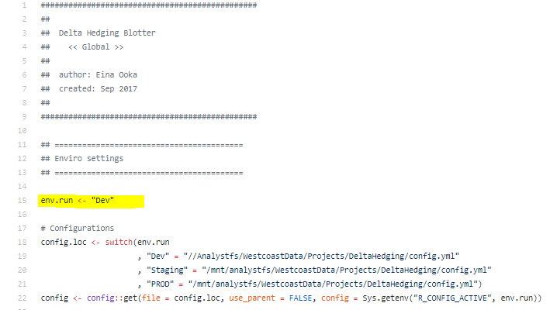
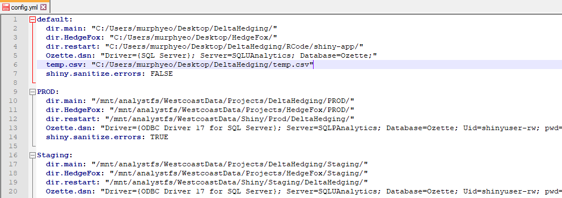
Managing connection strings

Slide 20
config
Use ‘config’ package for credential management.
Reason 1: directly typing in account info in the app code is not advised.
Reason 2: When config is stored somewhere other than in the code, deployment process is easier.
Reason 3: You can also manage file locations. (\mnt\...)
You could use a generic account of a production server for development, but recommend against it.
PROD app ↔ PROD database server
Staging app ↔ UAT database server

Slide 21
User Psychology on Wait Time
Users are generally more tolerant to waiting for the app to load at the start than waiting intermittently.
Getting information on the wait time helps users manage their expectations.
Use progress Bars

Slide 22
When to load data?

Slide 23
Git & GitHub

Slide 24
Git & GitHub
Git is a distributed version control system that runs on your local machine. It keeps track of your files and modifications to those files in your local “repository.”
https://git-scm.com/
GitHub is a website that allows you to publish your Git repositories online and collaborate with other people.
https://github.com/
We have a private account that is not open to public.

Slide 25
Exercise
Create a new repo.
Pull to the local machine.
Create a new branch.
Edit, save, stage, commit & push.
Make sure to mention the issue number.
Add comments on the issue page.

Slide 26
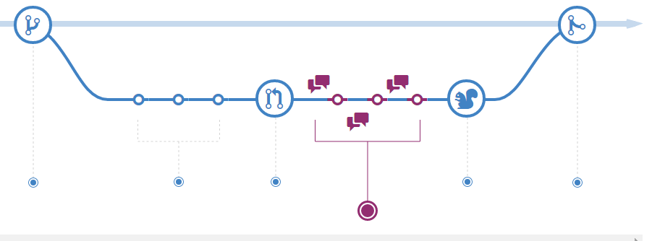
Understanding the GitHub Flow
https://guides.github.com/introduction/flow/
Create a brunch
Add commits
Open Pull Request
Discuss and review your code
Merge

Slide 27
Referencing Issue Number
Any commits that references the issue number will automatically appear in the issue page so that it’s very easy to find commits that are related to particular issues.
Or vice versa, if you are looking at a history of commits, and want to know details, you can go to the actual code changes, or the issue page to find out more.

Slide 28
https://resources.rstudio.com/shiny-developer-conference/shinydevcon-debugging-jonathanmcpherson-1080p
Debugging

Slide 29
Brekpoints works only within server.
Browser()
conditional
Profvis

Slide 30
Advanced Topics

Slide 31
Futures & Promises

Slide 32
Use of Module

Slide 33
Shiny App As Package

